Slide 1


Data Science-Based Prediction of Embryo Quality for Fertility Outcomes

Slide 2
Customer Overview
The client is an IVF and ART clinic focused on improving embryo implantation success rates.
Current challenge: Manual embryo grading is
subjective, time-consuming, and labor-intensive.
Goal: Adopt a data-driven, AI-based solution to assess embryo quality objectively.
Solution: Use deep learning (CNN) to automate image classification, reduce human bias, and enhance fertility outcomes.

Slide 3
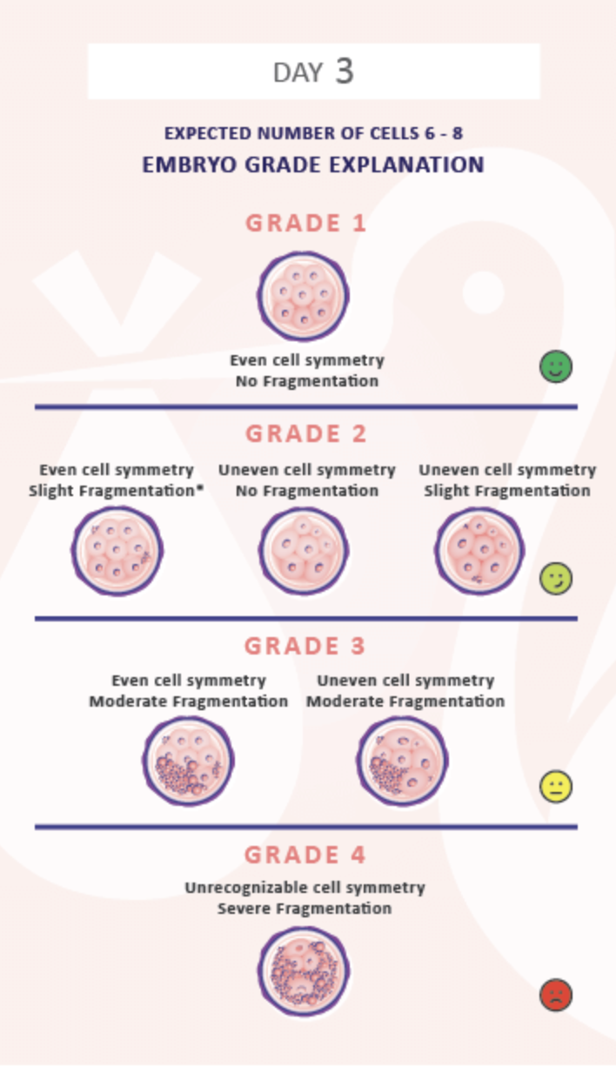
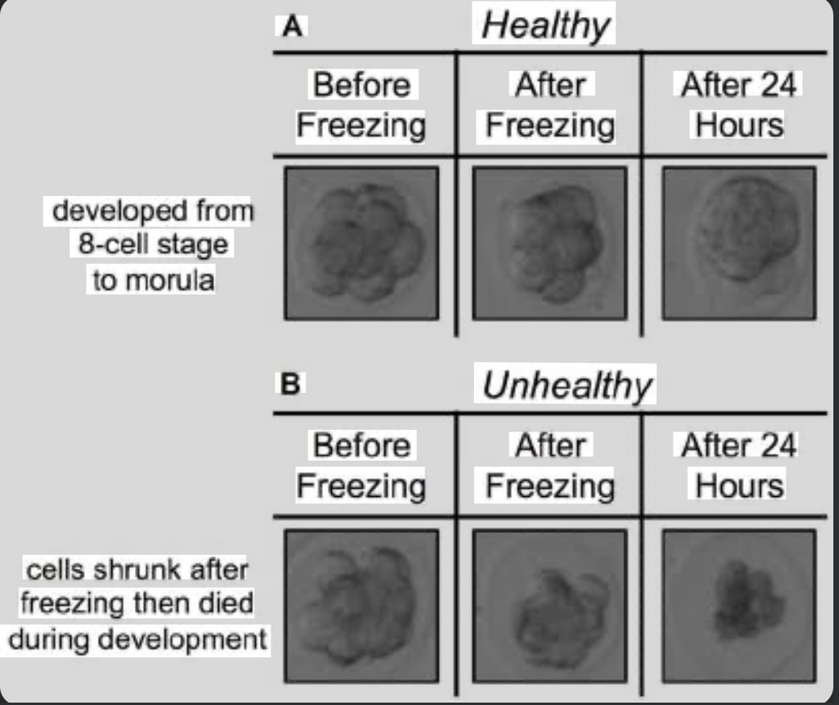
Embryo Day 3 & 4(Images)

Slide 4
Embryo Classification
Pre-trained models for Embryo Image Classification:
1. ResNet50 - Baseline pre-trained model with deep residual connections
2. EfficientNet - Scalable, high-performing architecture for transfer learning
3. MobileNet - Lightweight and optimized for real-time or mobile deployment

Slide 5
Which of the pre-trained model effective?
EfficientNet is generally the best pre-trained model for embryo image classification.
Because:
EfficientNet balances accuracy and computational efficiency better than most CNNs.
It has been widely used in medical imaging (retinal scans, ultrasound, embryo viability, etc.).
Its compound scaling (width, depth, resolution) helps it generalize better to subtle biological image differences.
In embryo classification studies, EfficientNet often achieves the highest F1-score and accuracy compared to other CNNs.

Slide 6





Business Understanding
Business Problem
Business Success Criteria
High Level Solution: Implement a deep learning–based system using Convolutional Neural Networks (CNNs) to automatically classify embryo images by quality.
Increase the success rate of ART procedures by atleast 10%
Objectives
Economic Success Criteria
Maximize the success rate of ART Procedures.
Achieve a cost saving of atleast 25% by reducing the
expenditure on working with embryos of lower grading.
Constraints
Minimize the treatment cost.

Slide 7
Project Team
Ace Angelo Bueno – Project Lead & Data Scientist
Responsible for data preprocessing, CNN model development, analysis, and presentation of results.
Supported by literature research and open-source embryo image datasets for model development.

Slide 8
Research Work
Please refer to this sheet for the Research Tracker Template.
Additionally, here are the details of the project “Data Science-Based Prediction of Embryo Quality for Fertility Outcomes”
Used embryo image dataset (CSV file linked) for analysis and model training.
Applied CNN-based deep learning for embryo classification.
Conducted data cleaning, augmentation, and feature analysis.
Evaluated performance using standard ML metrics.
Goal: Automate embryo grading and enhance IVF outcomes.

Slide 9
High Level Design Document
Training Pipeline
Inference Pipeline
Data Collection → Data Preprocessing → Model Training → Model Evaluation → Model Export
Input Image → Preprocessing → Model Inference → Output Prediction → Dashboard Visualization
Embryologist uploads Day 3 or Day 4 embryo image
Image is processed and fed into the trained model
Model predicts “Healthy” or “Unhealthy” embryo
Results shown in a dashboard with confidence score
Combined Google (Day 3 & 4) and Kaggle datasets
Applied image preprocessing (resize, normalization, augmentation)
Trained using MobileNet, EfficientNet, and ResNet50 (transfer learning)
Evaluated using accuracy, precision, recall, F1-score
Saved best-performing model for deployment

Slide 10
Decision Analysis and Resolution (DAR)
Criteria | Database 1: : Local Files | Database 2: Local SQL Database | Database 3: Cloud Database | Decision
Data Availability | ✅ Easy to access and create manually | ✅ Structured and easy to query | ✅ High availability and remote access | ✅ Cloud Database — ensures consistent access and sharing across environments
Data Quality | ⚠️ Prone to manual errors, duplicates | ✅ Schema validation improves quality | ✅ Built-in validation and backups | ✅ Cloud Database — provides automated quality control and versioning
Cost | ✅ Free and simple | ⚠️ Low to moderate (requires setup) | ⚠️ May incur monthly hosting costs | ✅ Local SQL Database — cost-effective for small projects
Timeliness | ⚠️ Manual updates required | ✅ Moderate (can automate refresh) | ✅ Real-time data sync possible | ✅ Cloud Database — faster retrieval for AI model integration
Scalability | ⚠️ Limited to local machine | ✅ Moderate scalability | ✅ Highly scalable for large datasets | ✅ Cloud Database — best for future expansion
Compliance | ⚠️ Manual data protection | ✅ User roles and permissions | ✅ High compliance (e.g., GDPR-ready) | ✅ Cloud Database — ensures better data security and compliance
Integration Complexity | ✅ Simple for standalone work | ⚠️ Requires setup and drivers | ⚠️ Needs cloud connection and credentials | ✅ Local SQL Database — simpler for model experimentation phase

Slide 11
Low Level Design Document
Training Pipeline
Inference Pipeline
Data Collection → Data Preprocessing → Model Training → Model Evaluation → Model Export
Image Input → Preprocessing → Model Loading → Prediction → Output Classification
Combined Google (Day 3 & Day 4) and Kaggle embryo classification datasets
Applied preprocessing: resize, normalization, data augmentation
Implemented MobileNet, EfficientNet, and ResNet50 (transfer learning)
Configured training with Adam optimizer, early stopping, and learning rate scheduler
Evaluated using accuracy, precision, recall, and F1-score
Exported best-performing model for deployment
User uploads embryo image (Day 3 or Day 4)
Image is resized and normalized to match training format
Best model (EfficientNet) is loaded from saved weights
Model predicts Healthy or Unhealthy embryo class

Slide 12
Data Understanding
Volume, Size, Type of data
Key Variables
1,000–5,000 embryo images (~50–200 KB each) with labels (High/Medium/Low).
Image_ID, Embryo_Image, Stage, Cell_Count, Quality_Score.
Data Sources
Initial Observations
IVF clinic repository, optional open-source datasets.
Some image quality issues, possible class imbalance, mostly complete metadata.

Slide 13
Data Preparation
Preprocessing Techniques
Steps Taken:
Challenges:
Image Resizing: Standardized all embryo images to 224x224 pixels to match CNN input requirements.
Normalization: Scaled pixel values to 0–1 to improve model convergence.
Data Augmentation:
  Rotation, horizontal/vertical flipping, zooming, brightness adjustment.
  Helps address class imbalance and improve model generalization.
Noise Removal / Image Enhancement: Applied filters to reduce blur and enhance contrast.
Label Encoding: Converted categorical quality scores (High, Medium, Low) into numerical labels for CNN classification.
1. Data Cleaning:
  Removed corrupted or incomplete images.
  Filled or removed missing values in cell count or stage labels.
2. Data Splitting:
  Training set: 70%
  Validation set: 20%
  Test set: 10%
3. Data Augmentation & Balancing:
  Applied augmentation to underrepresented classes (Low-quality embryos).
4. Final Verification:
  Checked image-label alignment and dataset consistency.
Image Quality Variability: Some images were blurred, poorly illuminated, or partially occluded.
Class Imbalance: High-quality embryos dominated the dataset, requiring augmentation.
Missing Metadata: A few images lacked stage or cell count labels.
Dataset Size: Limited dataset for training deep CNN required careful augmentation to prevent overfitting.

Slide 14
Model Selection - DAR
Criteria | Model 1 | Model 2 | Model 3 | Decision
Performance & Resource Utilization | ✅ Fast training, low GPU memory | ⚠️ Moderate GPU usage, slower than simple CNN | ⚠️ Very high GPU/memory usage, long training time | ✅ Simple CNN – efficient for research-scale dataset
Ease of Use | ✅ Easy to implement, fewer layers | ⚠️ Moderate complexity, pretrained weights require adaptation | ⚠️ Complex architecture, tuning needed | ✅ Simple CNN – minimal setup and tuning
Accuracy and Quality | ⚠️ Moderate accuracy on complex images | ✅ High accuracy, handles complex features well | ✅ High accuracy, may slightly outperform ResNet | ✅ ResNet-50 or Simple CNN depending on dataset size and resource;
System Requirements | ✅ Low hardware requirements | ⚠️ Requires GPU for efficient training | ⚠️ Requires high-end GPU & memory | Simple CNN – compatible with available resources
Scalability | ⚠️ Limited if dataset grows large | ✅ Can scale with transfer learning | ✅ Scalable, but resource-heavy | ResNet-50 – better for future expansion, but for current project, Simple CNN sufficient

Slide 15
Evaluation
Metrics:
Performance:
Issues Identified:
To assess model performance, the following metrics were used:
Accuracy: Percentage of correctly classified embryos.
Precision: Ability to correctly identify embryos of a specific quality class.
Recall (Sensitivity): Ability to detect all embryos of a given class.
F1-Score: Harmonic mean of precision and recall, balances false positives and false negatives.
Confusion Matrix: Visualizes true vs. predicted classifications across all classes.
Class Imbalance: Fewer Low-quality embryos → slightly lower precision and recall.
Image Quality Variability: Blurred or low-contrast images affected model predictions.
Limited Dataset Size: Small dataset may limit generalization; more images could improve accuracy.
Overfitting Risk: High training accuracy vs. slightly lower validation accuracy; addressed with dropout and data augmentation.
~85–88% accuracy; high-quality embryos classified most accurately

Slide 16
Deployment
Current Status:
Integration:
Remaining Tasks:
Model Development: CNN model fully trained, validated, and saved.
Testing: Model tested on held-out dataset with ~85–88% accuracy.
Data Preparation Pipeline: Preprocessing, augmentation, and label encoding completed.
Current Integration:
  Model ready to be integrated into lab workflow or decision-support system.
  Preprocessing and inference pipelines defined for real-time embryo image input.
Planned Integration:
  Connect trained CNN to IVF clinic software or dashboard.
  Automate prediction results display for embryologist review.
1. Deployment to Production/Clinic Environment – integrate model with lab systems.
2. User Interface / Dashboard – display predictions and confidence scores for embryologists.
3. Monitoring & Maintenance – track model performance, retrain with new images over time.
4. Validation with Live Data – test on new IVF cycles to ensure consistent performance.
5. Documentation & Training – provide user guide for lab staff.

Slide 17
Monitoring and Maintenance
Strategy:
Periodic reviews:
Track performance, data quality, error logging, feedback from embryologists.
Monthly: Accuracy check on new images
Quarterly: Retraining with new data
Annual: Full system evaluation and upgrades
Data Drift, Model Drift, and Concept Drift
  Data Drift: Changes in input embryo images (lighting, devices).
  Model Drift: Decline in prediction performance over time.
  Concept Drift: Changes in clinical definition of “high-quality” embryos.
PESTEL Conditions
Political/Legal: Health regulations, data privacy laws (HIPAA, GDPR)
Economic: Budget and clinic resource constraints
Sustainability, Regulatory, and ESG Considerations
  Sustainability: Reduces repeated IVF cycles → saves resources & energy
  Regulatory: Follow healthcare data protection and clinical protocols
  ESG: Ethical embryo selection, patient outcomes, responsible AI use

Slide 18








info@aispry.com
aispry.com
Malaysia: Level 16, 1 Sentral, Jalan Stesen Sentral 5, Kuala Lumpur Sentral,
50470 Kuala Lumpur, Federal Territory of Kuala Lumpur
AiSPRY has a global footprint in countries such as
India | Malaysia | USA | UK | Australia
Accreditation to international certiﬁcation bodies

